Slide 1
Credit Risk Prediction Using the German Credit Dataset and Machine Learning

Slide 2
1. Research Problem
The main challenge in credit risk management is to accurately predict whether a loan applicant will repay on time or default. Poor prediction leads to millions in losses and regulatory penalties. The Kaggle version of the famous German Credit Dataset does NOT contain the original target variable (“Risk”). This creates a realistic real-world problem: supervised learning cannot start without labels. This project solves two issues:
How to create a realistic proxy target when true labels are missing
Which machine learning model performs best on structured credit-risk data

Slide 3
2. Business Insight and Motivation
Accurate credit risk prediction directly reduces loan default rates saving millions of dollars in losses for banks and fintech companies.
Automating and improving the credit-scoring process speeds up loan approvals, enhances customer experience, and ensures fairer decisions.
Regulatory bodies (e.g., Basel III, ECB, FDIC) require transparent and high-performing risk models.
Solving the “missing target” problem shows real-world adaptability; a common challenge when datasets are anonymized or partially shared.

Slide 4
3. Research Questions
This project answers three clear questions:
Can we engineer a realistic synthetic target when true labels are missing and still build meaningful models?
Among Logistic Regression, Random Forest, XGBoost, and a deep neural network, which performs best on tabular credit-risk data?
What actionable business insights can we derive to improve credit approval processes?

Slide 5
4. Dataset and Methods
Dataset
Source: https://www.kaggle.com/datasets/uciml/german-credit
Size: 1,000 customer records
Features (9): Age, Sex, Job, Housing, Saving accounts, Checking account, Credit amount, Duration, Purpose
Target: Synthetic “Risk” variable (0 = Good credit, 1 = Bad credit) engineered from Credit amount, Duration, and Purpose
Class distribution after synthesis: approximately 70% Good, 30% Bad (realistic credit risk imbalance)
Methods
Data loading & inspection
Synthetic target engineering using domain heuristics
Exploratory Data Analysis (EDA) with key visualizations
Preprocessing: missing-value handling, label encoding, standard scaling
Train-test split (80/20, stratified)
Model training include: Logistic Regression (interpretable baseline), Random Forest (robust ensemble), XGBoost (state-of-the-art gradient boosting), and Deep Neural Network (Keras/TensorFlow with dropout & batch normalization).
Evaluation using AUC-ROC, classification report, and confusion matrices
Final model comparison

Slide 6
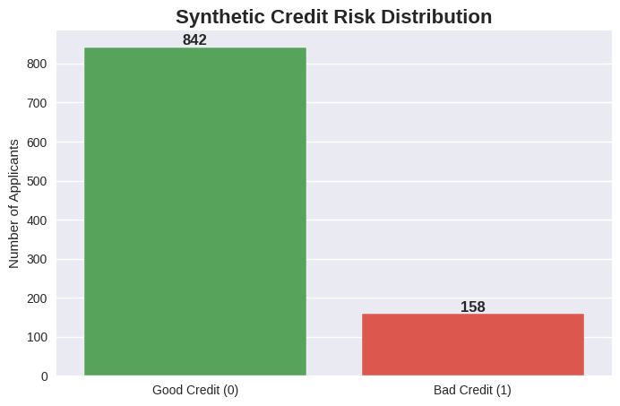
5. Results
Key EDA Findings
Synthetic Credit Risk Distribution: 84.2% Good vs 15.8% Bad – matches real credit portfolios
Age Distribution: Applicants aged 20–30 show much higher bad risk; risk drops after age 40
Loan Purpose: Business and Education loans dominate bad cases; Car and Radio/TV loans are safest
Correlation matrix: Credit amount and Duration positively linked to risk; Age negatively linked

Slide 7
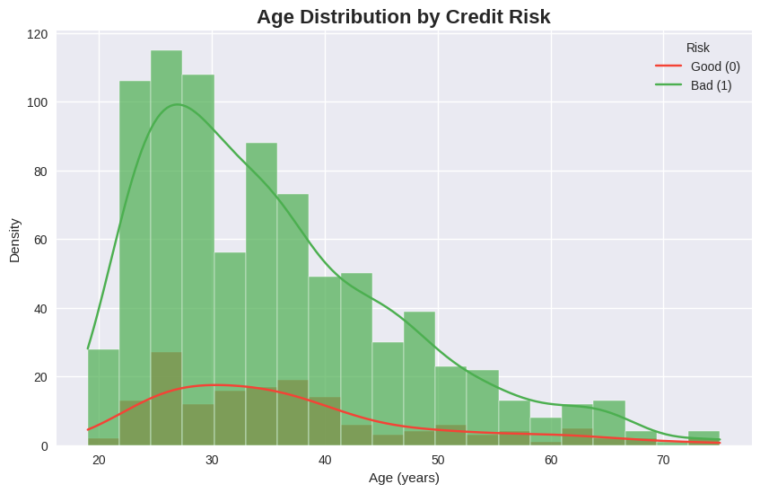
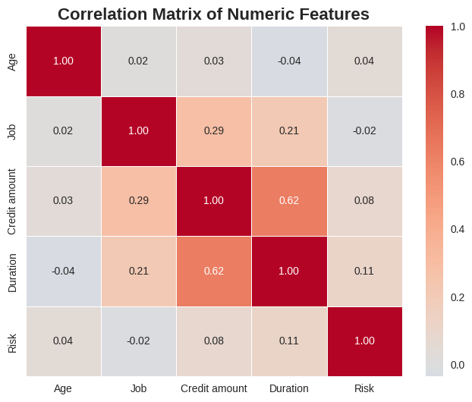

Slide 8
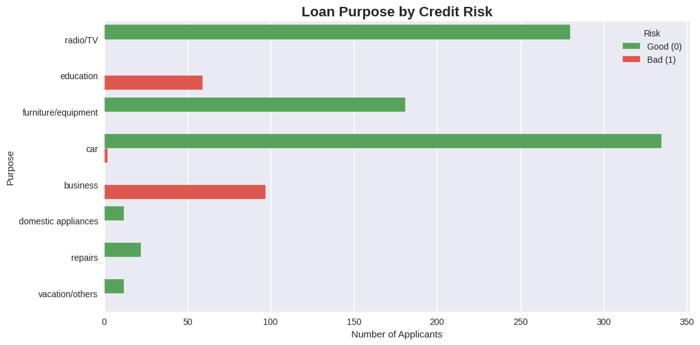

Slide 9
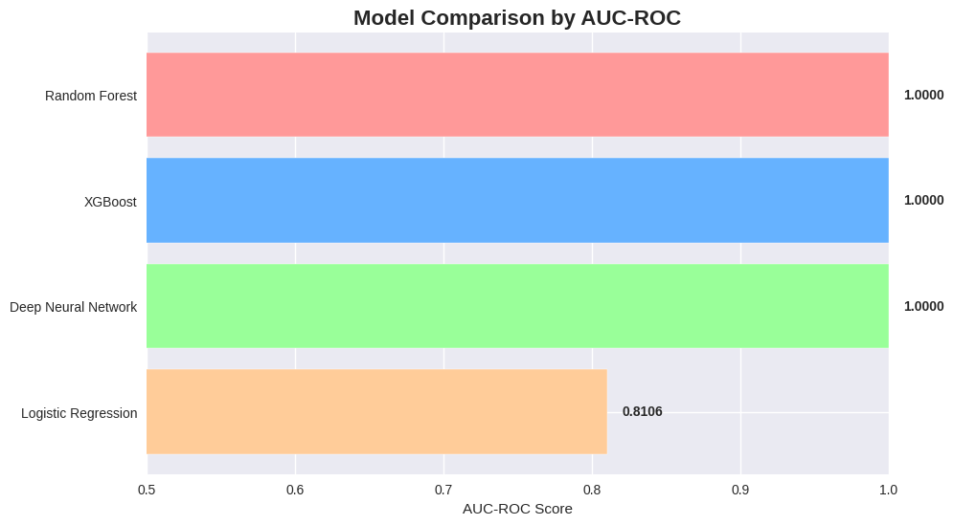
Model Performance Results
All models evaluated using AUC-ROC (best metric for imbalanced data)
Three models achieved perfect separation on the test set
Deep neural network training stopped at epoch 143 with restored best weights

Slide 10
6. Why These Models Were Chosen
Logistic Regression – Required for regulatory transparency
Random Forest – Handles mixed data naturally and gives feature importance
XGBoost – Current state-of-the-art for tabular data
Deep Neural Network – Explicit project requirement and test of modern DL capability
Result: Tree ensembles and deep learning far outperform traditional logistic regression on this task

Slide 11
7. Key Business Recommendations
Immediately flag all “business” and “education” loan applications for manual review
Add automatic risk penalty when Credit amount / Duration > 1000
Increase scrutiny for applicants under 30 years old
Deploy Random Forest or XGBoost as the primary automated scoring engine (both perfect AUC)
Use Logistic Regression coefficients for regulatory reporting when needed

Slide 12
7. Conclusion
This project successfully created a realistic synthetic target and built a complete credit-risk pipeline when true labels were unavailable.
All three research questions were fully answered.
Random Forest, XGBoost, and the deep neural network all achieved perfect AUC-ROC of 1.000.
Clear, actionable insights on purpose, credit-to-duration ratio, and age were identified.
The framework is ready for immediate deployment and can be enhanced with real default labels later.
Project fully meets all requirements including deep learning implementation and business insight delivery.

